Slide 1

Blood Bank Inventory Database
By: Kenny Mead, Kyle Droulard, and Nisargkumar (Nisark) Patel

Slide 2


What exactly is it?
Summed up, its a blood bank inventory system that:
Processes requests for blood from hospitals
Takes in blood donations from donors
Tracks each blood banks inventory for each blood type

Slide 3


Problem Statement: Why?
Wanted to develop an inventory type system that would:
Be able to add/remove items efficiently
Be simple to use
Why an Inventory system?
Wanted to choose a topic that would not be too complicated
Our goal was to focus on learning how to create SQL databases and try to use what we learned in class

Slide 4





Our Plan
Implement an SQL database using a website interface and python to process data and host the webserver.
Python
PyCharm
Tornado Web Server
PyMySQL Library
SQL
MySQL Workbench
Website
HTML/CSS
JavaScript
jQuery

Slide 5
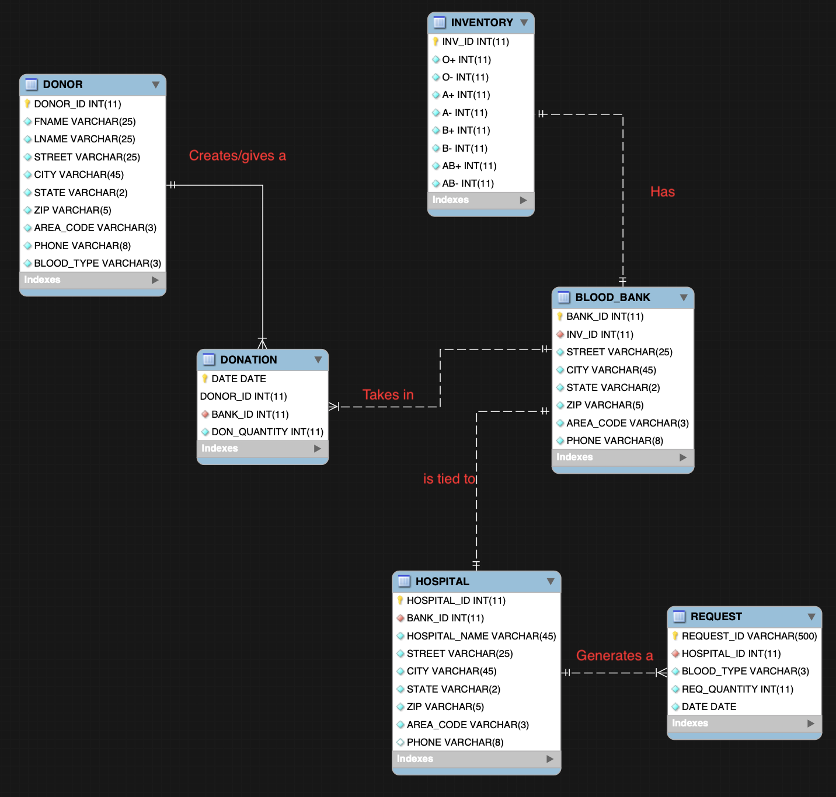

Slide 6
DEMO

